Slide 1
Pattern Classification All materials in these slides were taken from Pattern Classification (2nd ed) by R. O. Duda, P. E. Hart and D. G. Stork, John Wiley & Sons, 2000 with the permission of the authors and the publisher

Slide 2
Chapter 3: Maximum-Likelihood and Bayesian Parameter Estimation (part 2)
Bayesian Estimation (BE)
Bayesian Parameter Estimation: Gaussian Case
Bayesian Parameter Estimation: General Estimation
Problems of Dimensionality
Computational Complexity
Component Analysis and Discriminants
Hidden Markov Models

Slide 3
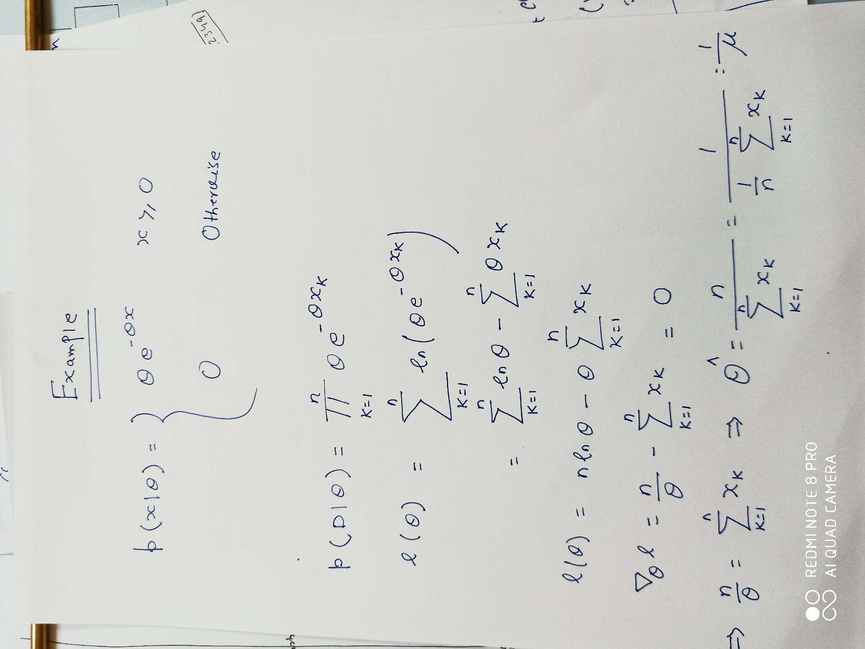
Example on MLE

Slide 4
Bayesian Estimation (Bayesian learning to pattern classification problems)
In MLE θ was supposed fix
In BE θ is a random variable
The computation of posterior probabilities P(ω_{i} | x) lies at the heart of Bayesian classification
Goal: compute P(ω_{i} | x, D)
Given the sample D, Bayes formula can be written
3

Slide 5
To demonstrate the preceding equation, use:
3

Slide 6
Bayesian Parameter Estimation: Gaussian Case
Goal: Estimate θ using the a-posteriori density P(θ | D)
The univariate case: P(μ | D)
μ is the only unknown parameter
(μ₀ and σ₀ are known!)
4

Slide 7
But we know
Plugging in their gaussian expressions and extracting out factors not depending on μ yields:
4

Slide 8
Observation: p(μ|D) is an exponential of a quadratic
It is again normal! It is called a reproducing density
4

Slide 9
Identifying coefficients in the top equation with that of the generic Gaussian
Yields expressions for μ_{n} and σ_{n}²
4

Slide 10
Solving for μ_{n} and σ_{n}² yields:
From these equations we see as n increases:
the variance decreases monotonically
the estimate of p(μ|D) becomes more peaked
4

Slide 11
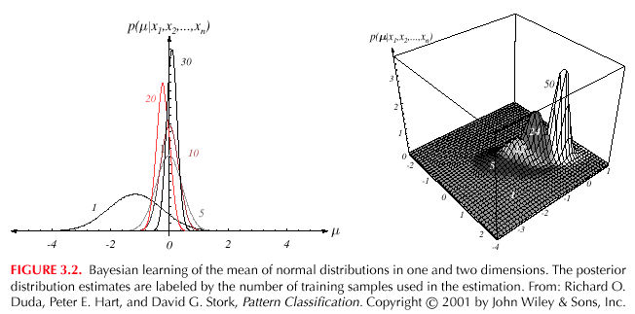
4

Slide 12
The univariate case P(x | D)
P(μ | D) computed (in preceding discussion)
P(x | D) remains to be computed!
It provides:
We know σ² and how to compute
(Desired class-conditional density P(x | D_{j}, ω_{j}))
Therefore: using P(x | D_{j}, ω_{j}) together with P(ω_{j})
And using Bayes formula, we obtain the
Bayesian classification rule:
4

Slide 13
3.5 Bayesian Parameter Estimation: General Theory
P(x | D) computation can be applied to any situation in which the unknown density can be parameterized: the basic assumptions are:
The form of P(x | θ) is assumed known, but the value of θ is not known exactly
Our knowledge about θ is assumed to be contained in a known prior density P(θ)
The rest of our knowledge θ is contained in a set D of n random variables x₁, x₂, …, x_{n} that follows P(x)
5

Slide 14
The basic problem is:
“Compute the posterior density P(θ | D)”
then “Derive P(x | D)”, where
Using Bayes formula, we have:
And by the independence assumption:
5

Slide 15
Convergence (from notes)

Slide 16
Problems of Dimensionality
Problems involving 50 or 100 features are common (usually binary valued)
Note: microarray data might entail ~20000 real-valued features
Classification accuracy dependant on
dimensionality
amount of training data
discrete vs continuous
7

Slide 17
Case of two class multivariate normal with the same covariance
P(x|ω_{j}) ~N(μ_{j},Σ), j=1,2
Statistically independent features
If the priors are equal then:
7

Slide 18
If features are conditionally independent then:
Do we remember what conditional independence is?
Example for binary features:
Let p_{i}= Pr[x_{i}=1|ω₁] then P(x|ω₁) is the product of the p_{i}
7

Slide 19
Most useful features are the ones for which the difference between the means is large relative to the standard deviation
Doesn’t require independence
Adding independent features helps increase r → reduce error
Caution: adding features increases cost & complexity of feature extractor and classifier
It has frequently been observed in practice that, beyond a certain point, the inclusion of additional features leads to worse rather than better performance:
we have the wrong model !
we don’t have enough training data to support the additional dimensions
7

Slide 20
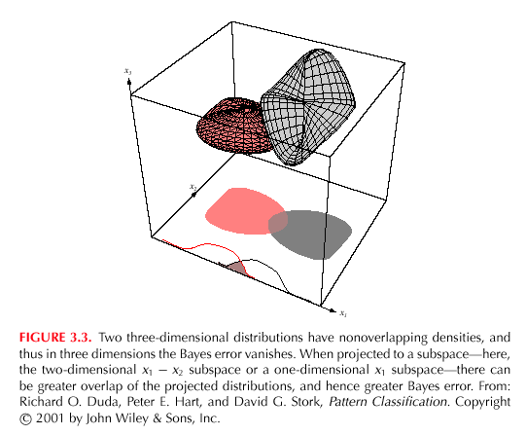
7
7
7

Slide 21
Computational Complexity
Our design methodology is affected by the computational difficulty
“big oh” notation
f(x) = O(h(x)) “big oh of h(x)”
If:
(An upper bound on f(x) grows no worse than h(x) for sufficiently large x!)
f(x) = 2+3x+4x²
g(x) = x²
f(x) = O(x²)
7

Slide 22
“big oh” is not unique!
f(x) = O(x²); f(x) = O(x³); f(x) = O(x⁴)
“big theta” notation
f(x) = θ(h(x))
If:
f(x) = θ(x²) but f(x) ≠ θ(x³)
7

Slide 23
Complexity of the ML Estimation
Gaussian priors in d dimensions classifier with n training samples for each of c classes
For each category, we have to compute the discriminant function
Total = O(d²n)
Total for c classes = O(cd²n) ≅ O(d²n)
Cost increase when d and n are large!
7

Slide 24
Overfitting
Dimensionality of model vs size of training data
Issue: not enough data to support the model
Possible solutions:
Reduce model dimensionality
Make (possibly incorrect) assumptions to better estimate Σ

Slide 25
Overfitting
Estimate better Σ
use data pooled from all classes
normalization issues
use pseudo-Bayesian form λΣ₀ + (1-λ)Σ_{n}
“doctor” Σ by thresholding entries
reduces chance correlations
assume statistical independence
zero all off-diagonal elements

Slide 26
Shrinkage
Shrinkage: weighted combination of common and individual covariances
We can also shrink the estimate common covariances toward the identity matrix

Slide 27
Component Analysis and Discriminants
Combine features in order to reduce the dimension of the feature space
Linear combinations are simple to compute and tractable
Project high dimensional data onto a lower dimensional space
Two classical approaches for finding “optimal” linear transformation
PCA (Principal Component Analysis) “Projection that best represents the data in a least- square sense”
MDA (Multiple Discriminant Analysis) “Projection that best separates the data in a least-squares sense”
8

Slide 28
PCA (from notes)

Slide 29
Hidden Markov Models:
Markov Chains
Goal: make a sequence of decisions
Processes that unfold in time, states at time t are influenced by a state at time t-1
Applications: speech recognition, gesture recognition, parts of speech tagging and DNA sequencing,
Any temporal process without memory
ω^{T} = {ω(1), ω(2), ω(3), …, ω(T)} sequence of states
We might have ω⁶ = {ω1, ω4, ω2, ω2, ω1, ω4}
The system can revisit a state at different steps and not every state need to be visited
10

Slide 30
First-order Markov models
Our productions of any sequence is described by the transition probabilities
P(ω_{j}(t + 1) | ω_{i} (t)) = a_{ij}
10

Slide 31
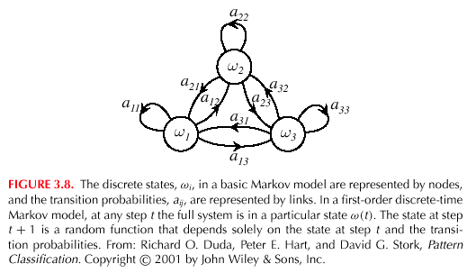
10

Slide 32
θ = (a_{ij}, ω^{T})
P(ω^{T} | θ) = a₁₄ . a₄₂ . a₂₂ . a₂₁ . a₁₄ . P(ω(1) = ω_{i})
Example: speech recognition
“production of spoken words”
Production of the word: “pattern” represented by phonemes
/p/ /a/ /tt/ /er/ /n/ // ( // = silent state)
Transitions from /p/ to /a/, /a/ to /tt/, /tt/ to er/, /er/ to /n/ and /n/ to a silent state
10

